Slide 1
Pentaho Project Setup and Governance Best Practices
Development Guidelines & Lifecyle Management
James O’Reilly

Slide 2
Project Setup and Governance Use Case
Secondhand Lens is deploying 2 ETL Projects that each have multiple scrums
Project 1 = pr_sls_dwh
scrum1 = onboarding - sls_raw
scrum2 = rapid prototyping - agile_sls
Scrum3 = star schema – sls_dma
Project 2 = Data exports ….
scrum1 = data exports job
Customer has 4 environments (local, dev, uat, prod) that are each running on a single Pentaho Server

Slide 3
Project Setup and Governance Challenges
Multiple developers will be collaborating, collaboration requires development standards and a central repository of artifacts
The Projects can contain multiple scrums and there will be shared artifacts across projects and scrums
The implementation needs to integrate with the Customer’s Version Control System (VCS)
The implementation needs to be environment agnostic, requiring the separation of content and configuration

Slide 4
Project Setup and Governance Challenges
The quality of the solution needs to be assured before it hits production requiring different tests to be performed
Deployment of artifacts across environments needs to be automated
The final solution will be supported by a different team, so logging and monitoring should be put in place that allows for a supported solution
Failed jobs should require a simple restart requiring restartability to be part of job design

Slide 5
Phase 1 – Project Configuration
Lifecycle Management
Version Control System integration (Git)
File-based development (no repository)
Configuration management: separating content from configuration
Development standards
Logging and monitoring

Slide 6
Phase II – Testing, CI / CD
Testing strategies (unit, integration, functional and non-functional tests)
Creating a testable ETL solution
Continuous Integration
Deployment strategies
Extending the solution to BA development

Slide 7
Lifecycle Management

Slide 8
Lifecycle Management
3rd Party VCS Functionality
Commit XML files to VCS
Filesystem DEV
Stage (eg.):
DEV
UAT
PRD
Build/Import from VCS
Pentaho Repository UAT
VCS Release Management etc.
Release
VCS
Build/Import from VCS
Pentaho Repository PRD
TMP Filesystem (Im/Export)

Slide 9
Lifecyle Management
Version Control System integration (eg. Git)
Working file-based in DEV (local), Pentaho Repository in UAT & PRD
Using environment variable ${Internal.Entry.Current.Directory} for any internal references
Turn off version control and comment tracking for Pentaho Repository
Communication between environments by using packaging & deployment process

Slide 10
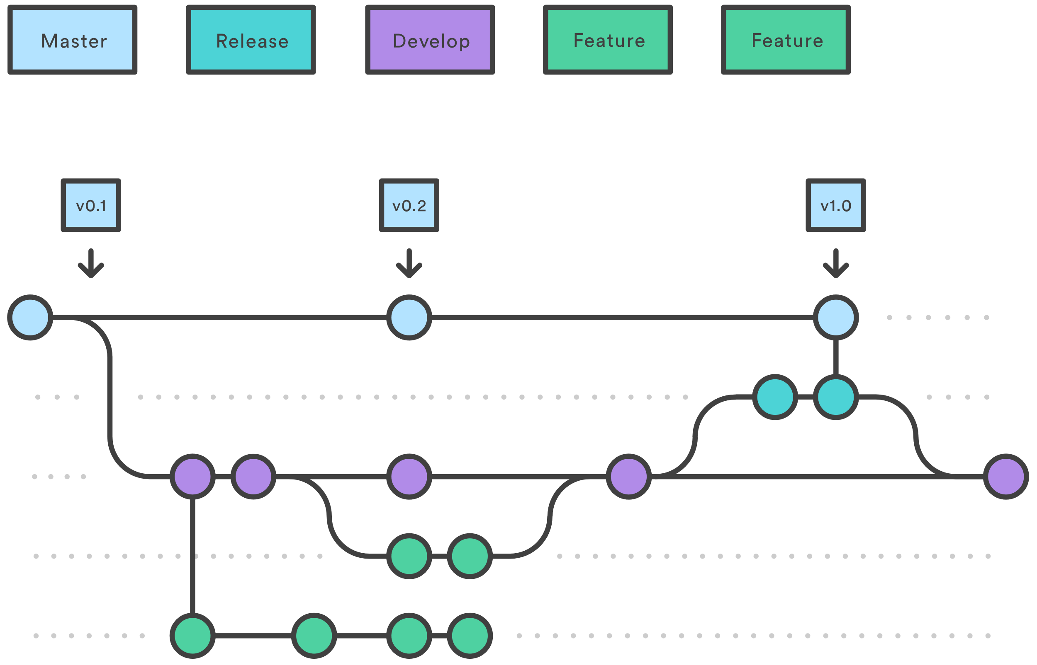
Git Integration
Learning the basics of Git: https://try.github.io
Branching workflow: Gitflow
Notes:
Which branch gets deployed to which environment?

Slide 11
File-based Development

Slide 12
File-based Development (DEV)
Connections will be shared via shared.xml
Run configurations via metastore (metadata about the stored artefacts)
Spoon settings via .spoonrc
Repository connections via repositories.xml
Variables
kettle.properties for global variables (server wide, across projects)
project.properties for project specific variables
Job.properties for specific job resources

Slide 13
Separating Configuration from Content: Content

Slide 14
Seperating Configuration from Content
Version-controlled Content
PDI
repository
sql (incl. DDL)
scripts
plugins
master files (input, lookup)
Documentation
BA Server
repository
metadata
mondrian

Slide 15
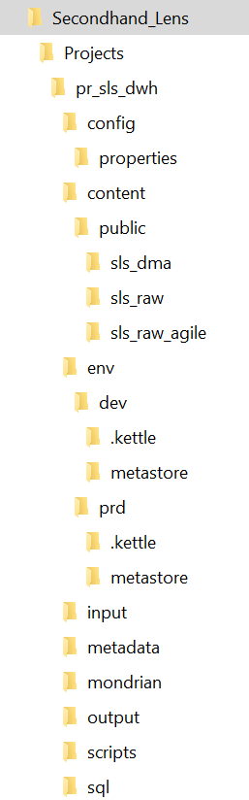
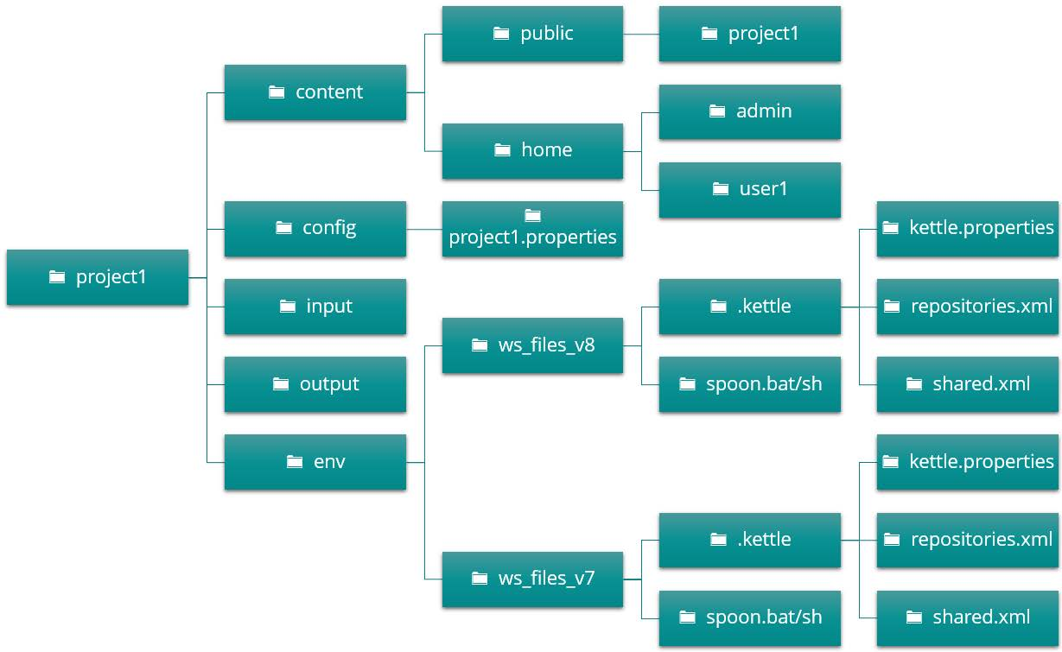
Project Folders

Slide 16
Content Setup
config
properties
content
public
sls_raw
env
dev
.kettle
metastore
Projects
pr_sls_dwh
prd
.kettle
input
metastore
metadata
mondrian
output
scripts

Slide 17
Separating Configuration from Content: Configuration

Slide 18
Seperating Configuration from Content
Version-Controlled Configuration
PDI
.kettle
kettle.properties
repositories.xml
shared.xml
.spoonrc
properties
metastore
pentaho-big-data-plugin
spoon.bat (per environment)
DI Server
connections
schedules
server config files
BA Server
connections
schedules
acls
server config files

Slide 19
Variables: kettle vs project.properties
kettle.properties for global variables
Server wide, across projects
Require JVM restart
common.properties for cross-project variables
Not having them in kettle.properties provides extra flexibility
project.properties for project specific variables
Use job entry (set variables) to set the variable
job.properties for (sub) job specific variables

Slide 20
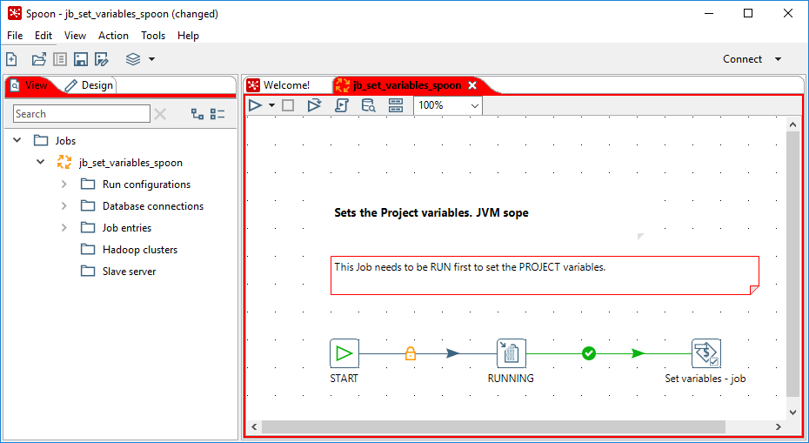
Configuration Setup
Variables
Logging DB connection defined via kettle.properties
Logging setup via kettle.properties variables
Project specific DB connections via project.properties

Slide 21
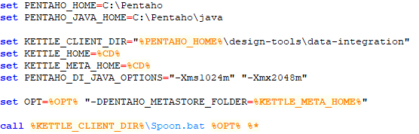
Spoon.bat/sh
Use the “right Spoon” for the right environment-container combination
Avoid using the incorrect variables values

